Slide 1

Drama At Cornwallis Academy
Year 8 – LESSON 7
Lesson Objective:
-The importance of reflecting on the progress you have made this term. -To discuss your strengths and weaknesses and those of others.
-The importance of peer and self assessment
Success Criteria:
Performing and Creating
Level 3
I can sustain a role that I have created for some of the performance. I am more comfortable being led by others in a group situation.
Level 4
I can stay in role for good parts of my performance, occasionally struggling to keep focused. I will make a reasonable contribution to my groups work, sharing some simple ideas.
Level 5
I can stay in role for most of the performance with few distractions. I will make a positive contribution to a group, sharing ideas and showing some leadership.
Level 6
I can consistently stay in role for the whole of the performance. I Contribute ideas very well to the group I’m in and am capable of showing good leadership skills

Slide 2
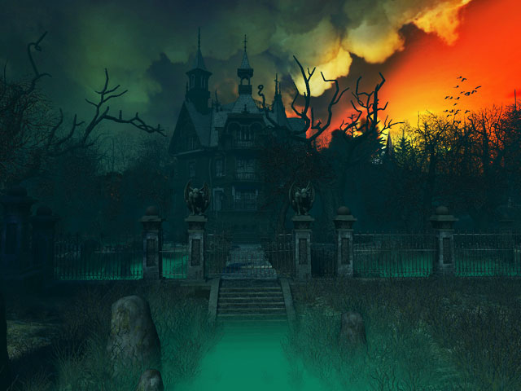
Lesson Objective:
-The importance of reflecting on the progress you have made this term. -To discuss your strengths and weaknesses and those of others.
-The importance of peer and self assessment
Activity 1 – Murder Mystery game 7 – Who is the murderer?
Success Criteria:
Creating and Performing
Level 3
I can sustain a role that I have created for some of the performance. I am more comfortable being led by others in a group situation.
Level 4
I can stay in role for good parts of my performance, occasionally struggling to keep focused. I will make a reasonable contribution to my groups work, sharing some simple ideas.
Level 5
I can stay in role for most of the performance with few distractions. I will make a positive contribution to a group, sharing ideas and showing some leadership.
Level 6
I can consistently stay in role for the whole of the performance. I Contribute ideas very well to the group I’m in and am capable of showing good leadership skills

Slide 3
Murder Mystery Assessment
In today’s lesson we will be looking back at your performances from last lesson. You will need to write an end of term reflection that focuses on the following areas:
Make a list of your strengths and then weaknesses that you have identified from the viewing.
Now you need to list/ describe everything you have taken out of this terms lessons in order to demonstrate what you have learnt.

Slide 4

Task 1 – Watching the performances You will now watch your pieces and discuss how successful they were. The rest of the class with need to give positive criticism looking at what you did well and what didn’t work as well. Remember to think about the following this:
A Murder
Suspects
Victim
Murderer
Detective
You must not show the Murder as we will need to guess who did it.
Did they face the audience?
How well did they / you use their/ your voice and body to create a character?
Murder Mystery Assessment
Notes:
You will need to complete an end of unit assessment based on their final performance here.

Slide 5
You will now need to complete the given self assessment reflection sheet, logging your answer from the previous questions.
Murder Mystery

